Slide 1
Fostering psychological flexibility and nurturing communities through acceptance and mindfulness-based approaches
Jennifer Block-Lerner, Ph.D. Amanda Aster, Psy.D. Paola Ricardo, B.A.
Morris County Psychological Association
May 9, 2018

Slide 2
Important considerations for continuing education
Diversity – these types of approaches are being studied across the globe. We will do our best to address issues relevant to individuals from diverse backgrounds and with a variety of demographic characteristics (with diversity defined broadly to include age and life cycle stage, gender, gender identity, race, ethnicity, culture, national origin, religion, sexual orientation, ability status, language, socioeconomic status, immigration status, and level of acculturation, as well as the intersection of these characteristics and implications with regard to power and privilege)
Accuracy and utility of materials presented - MCPA/NJPA does not endorse the presented material as the only approach to a given area of study or therapeutic approach.
Identification of conflicts of interest and commercial support - One presenter (JBL) is the co-editor of a book on mindfulness-based interventions within the higher education setting. No other conflicts of interest have been identified.

Slide 3
Objectives and intentions
Objectives
Describe components of the psychological flexibility model
Explore ways to model and promote a therapeutic stance consistent with ACT and other mindfulness- and acceptance-based approaches
Develop practices consistent with ACT and other mindfulness- and acceptance-based approaches that aim to foster psychological flexibility and nurturing communities with a wide range of populations
Intentions and stance

Slide 4
Two mountains…

Slide 5
The path ahead this morning
Psychological flexibility
Definitions
Processes
Flexibility about flexibility
Glimpses into processes
Branching out – fostering nurturing communities
Just a taste – sharing resources

Slide 6
Psychological flexibility (PF)
Working definition - the capacity to fully contact the present moment and continuing or changing behavior in the service of one’s values (Bond et al., 2011)
Interconnected elements
Flexibility about flexibility
Elements not set in stone, one way of “cutting the pie”
Many ways of fostering these processes
Most closely connected with acceptance and commitment therapy (ACT); overlap with mindfulness-based stress reduction, mindfulness-based cognitive therapy, dialectical behavior therapy
Overlap/consistency/synergy with other orientations/perspectives

Slide 7
Hexaflex model of psychological flexibility

Slide 8
Six Crucial Questions
Marks & Femenella’s adaptation of Hayes et al., 2012
1. Are you able to be here? (What is your experience here and now?)
5. Are you willing to experience all of life in the service of your values?
4. What do you want your life to be about?
Psychological Flexibility
6. What value is this behavior in the service of?
2. Can you observe your thoughts and feelings? (Does thinking something make it so? Do you have to act on what you feel?)
3. Are you the same as your thoughts and feelings? (Who is it that observes your internal experience?)

Slide 9
Glimpses into these processes…

Slide 10
Ways of holding our emotional experiences

Slide 11
Hexaflex model of psychological flexibility

Slide 12
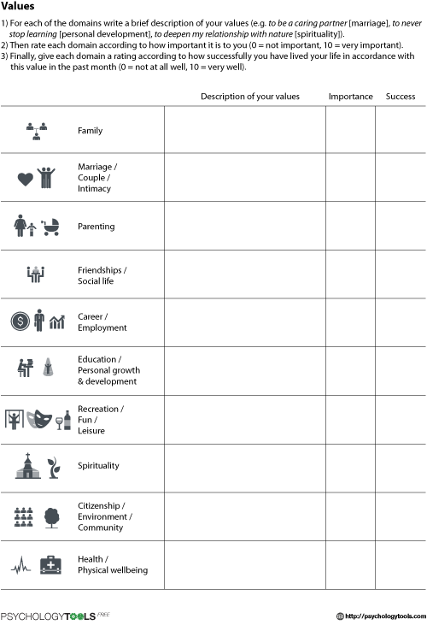
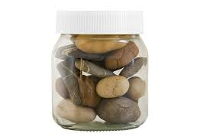
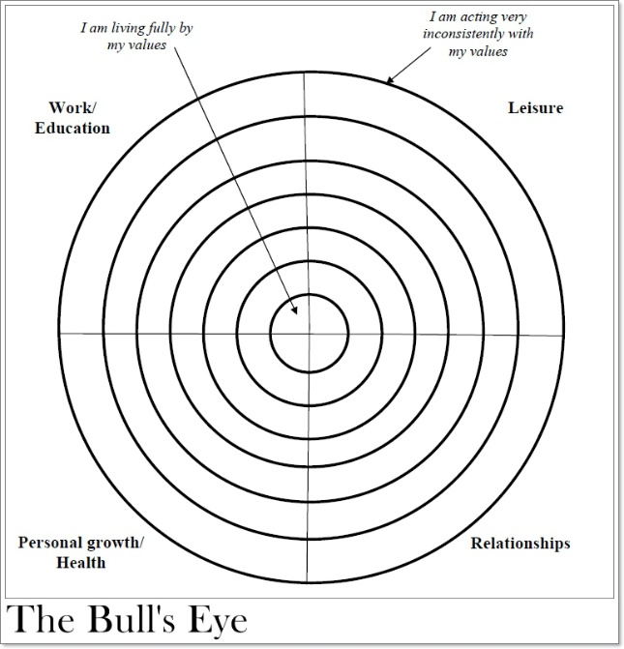
Exploring our values
What is important to me?
How do I want to engage in my life?
Dr. Russ Harris - Values vs. Goals
Tools
Big rocks metaphor
Bullseye
Perfect average day

Slide 13
Nurturing community
Role of these approaches in cultivating compassionate, positive, nurturing environments in all aspects of society (Biglan, 2015)
Individuals within communities
Higher education-based work
Curriculum-based workshops
Drop-in practice sessions
Work with faculty
Pathways to PF framework

Slide 14
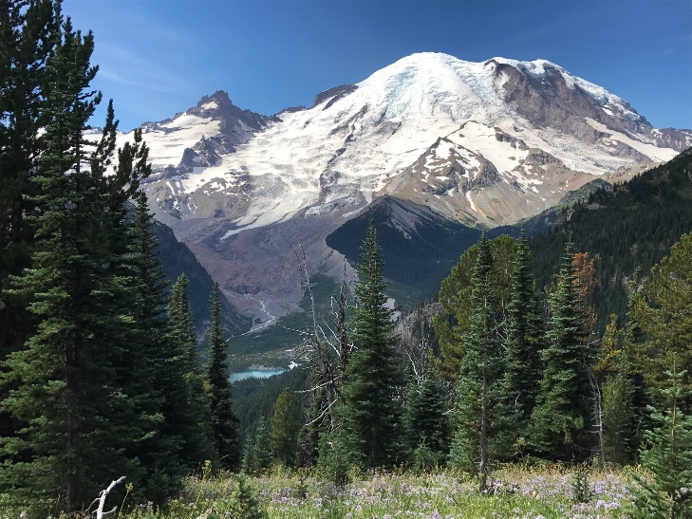
A note on self-as-context or perspective
A sense-of-self that is a consistent perspective from which to observe and accept all changing experiences
Chessboard…
Mountain meditation…
Main point: Whatever the weather, or whatever happens on the surface of the mountain – the mountain stands firm, strong, grounded, permanent. We can be like that mountain, observing thoughts, feelings, sensations, knowing inner stillness.

Slide 15
Relevance of these processes in/to our clinical work (from Wilson & DuFrene, 2008)
Acceptance
What are the biggest things I avoid in session?
What behavioral repertoires do I use to keep these hard things away?
What have the consequences of these choices been?
Defusion
What thoughts often occur to me in the therapy room?
What is my client typically doing when these thoughts come up?
What would it look like if I could have these thoughts and still do what I value in the room?

Slide 16
Relevance of these processes in/to our clinical work (from Wilson & DuFrene, 2008)
Self-as-context
What stories do I tell myself about who I am as I sit in the therapy room?
How do I think these stories might affect my clients?
What behaviors do I engage in to reinforce these stories or suppress them?
Contact with the present moment
At what times do I tend to lose contact with the present in therapy sessions?
How might these moments affect my clients?
What it might look like if I could remain in the room during these moments? How might my presence be of service to my clients?

Slide 17
Relevance of these processes in/to our clinical work (from Wilson & DuFrene, 2008)
Values
What matters to me as a therapist?
What comes up for me as I write down those words, as I claim this possibility?
What might it mean both to me and to my clients if I could act to further this value?
Committed action
What kinds of actions am I committed to in therapy sessions?
When do I notice myself turning away from these commitments?
Can I gently return to them? What does that look like for me?

Slide 18
Thank you for sharing this time with us
Select resources
https://contextualscience.org/clinical_resources
https://www.actmindfully.com.au/free_resources
https://mindfulwaythroughanxiety.com/resources/
http://www.drluoma.com/actresources.html
Contact information
Jennifer Block Lerner – jlerner@kean.edu
Amanda Aster - amandamaster88@gmail.com
Paola Ricardo – ricardop@kean.edu

Slide 19
Select references
Biglan, A. (2015). The nurture effect: How the science of human behavior can improve our lives and the world. Oakland, CA: New Harbinger.
Biglan, A., & Prinz, R. (2017). Progress in nurturing human well-being. Clinical Child and Family Psychology Review, 20, 1-2.
Bond, F. W., Hayes, S. C., Baer, R. A., Carpenter, K. C., Guenole, N., Orcutt, H.K….Zettle, R.D. (2011). Preliminary psychometric properties of the Acceptance and Action Questionnaire – II: A revised measure of psychological flexibility and acceptance. Behavior Therapy, 42, 676-688.
Hayes, S. C., Strosahl, K., & Wilson, K. G. (2012). Acceptance and commitment therapy: The process and practice of mindful change (2nd edition). New York, NY: The Guilford Press.
Hayes-Skelton, S. A., Calloway, A., Roemer, L., & Orsillo, S. M. (2015). Decentering as a potential common mechanism across two therapies for generalized anxiety disorder. Journal of Consulting and Clinical Psychology, 83, 395-404.
Levin, M. E., MacLane, C., Daflos, S., Seeley, J. R., Hayes, S. C., Biglan, A., & Pistorello, J. (2014). Examining psychological inflexibility as a transdiagnostic process across psychological disorders. Journal of Contextual Behavioral Science, 3, 155-163.
Twohig, M. P., & Levin, M. E. (2017). Acceptance and commitment therapy as a treatment for anxiety and depression: A review. Psychiatric Clinics of North America, 40, 751-770.
Williston, M., Block-Lerner, J., Wolanin, A., Gardner, F. (2014). Brief acceptance-based intervention for reducing missed first appointments at a community mental health center. Psychological Services, 11, 324-332.
Wilson, K. G., & DuFrene, T. (2008). Mindfulness for two. Oakland, CA: New Harbinger Publications.

Slide 20
Two mountains metaphor
It’s like you’re in the process of climbing up a big mountain that has lots of dangerous places on it. My job is to watch out for you and shout out directions if I can see places you might slip or hurt yourself. But I’m not able to do this because I’m standing at the top of your mountain, looking down at you. If I’m able to help you climb your mountain, it’s because I’m on my own mountain, just across a valley. I don’t have to know anything about exactly what it feels like to climb your mountain to see where you are about to step, and what might be a better path for you to take.
From Twohig (2004)

